Slide 1


Breath rate estimation pipeline
Pre-processing
Load 2 channels from CSV
Channel fusion
Via cross-correlation analyse 2 channels
Post-processing
Output signal is interpolated via linear interpolation (3-window moving average)
AI for building code skeleton and for PEP
Detrend to remove DC offsets
Bandpass filter – Butterworth 4 order [0.13 – 0.45 Hz]
RR estimation
Confidence
CC > 0.7 → average
CC < 0.7 → channel with the highest variance
Quality control and motion rejection:
Spectral purity checks if energy is in the breathing band
Motion detection checks for excessive amplitude
If confidence < 0.3 result is discarded
2 methods:
Welch: dominant peak in the power spectrum
Autocorrelation: dominant periodicity in the time domain
Combined to ensure consistency
f_{ACF} more resistant to motion artefacts

Slide 2
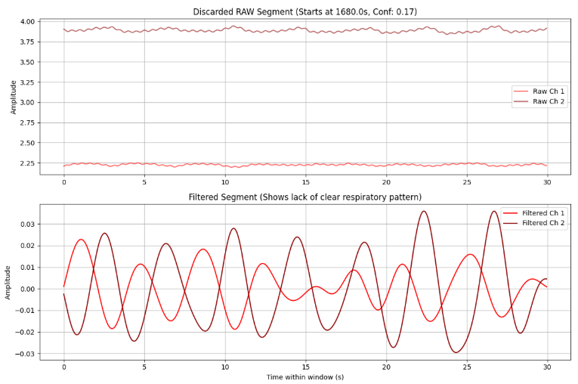
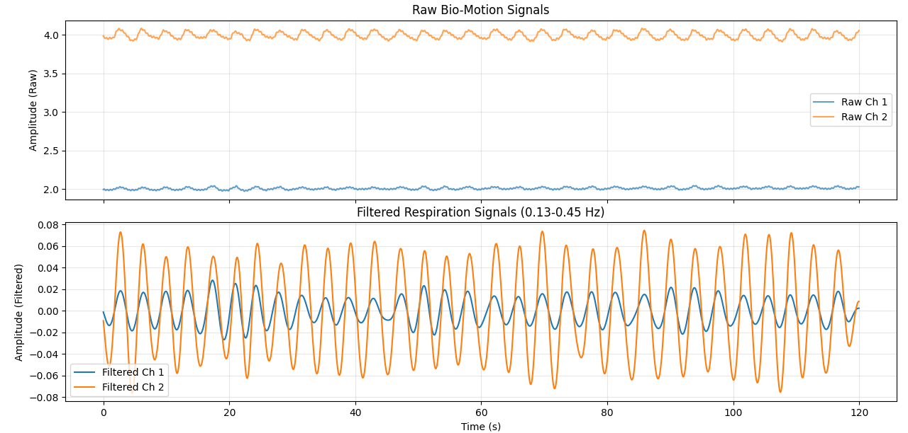
Signals pre-processing
BAD SEGMENT
GOOD SEGMENT

Slide 3
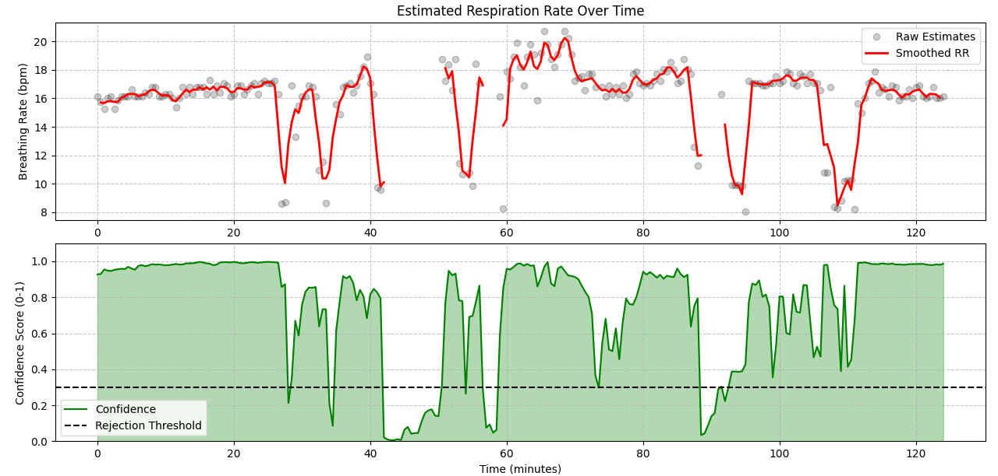
Results – RR and confidence

